Slide 1
Algorithms and Data Structures
Lecture XIII
Simonas Šaltenis
Aalborg University
simas@cs.auc.dk

Slide 2
This Lecture
Single-source shortest paths in weighted graphs
  Shortest-Path Problems
  Properties of Shortest Paths, Relaxation
  Dijkstra’s Algorithm
  Bellman-Ford Algorithm
  Shortest-Paths in DAG’s

Slide 3

Shortest Path
Generalize distance to weighted setting
Digraph G = (V,E) with weight function W: E → R (assigning real values to edges)
Weight of path p = v₁ → v₂ → … → v_{k} is
Shortest path = a path of the minimum weight
Applications
  static/dynamic network routing
  robot motion planning
  map/route generation in traffic

Slide 4
Shortest-Path Problems
Shortest-Path problems
  Single-source (single-destination). Find a shortest path from a given source (vertex s) to each of the vertices. The topic of this lecture.
  Single-pair. Given two vertices, find a shortest path between them. Solution to single-source problem solves this problem efficiently, too.
  All-pairs. Find shortest-paths for every pair of vertices. Dynamic programming algorithm.
  Unweighted shortest-paths – BFS.

Slide 5

Optimal Substructure
Theorem: subpaths of shortest paths are shortest paths
Proof (”cut and paste”)
  if some subpath were not the shortest path, one could substitute the shorter subpath and create a shorter total path

Slide 6
Negative Weights and Cycles?
Negative edges are OK, as long as there are no negative weight cycles (otherwise paths with arbitrary small “lengths” would be possible)
Shortest-paths can have no cycles (otherwise we could improve them by removing cycles)
  Any shortest-path in graph G can be no longer than n – 1 edges, where n is the number of vertices

Slide 7
Shortest Path Tree
The result of the algorithms – a shortest path tree. For each vertex v, it
  records a shortest path from the start vertex s to v. v.parent() gives a predecessor of v in this shortest path
  gives a shortest path length from s to v, which is recorded in v.d().
The same pseudo-code assumptions are used.
Vertex ADT with operations:
  adjacent():VertexSet
  keyd():int and setd(k:int)
  parent():Vertex and setparent(p:Vertex)

Slide 8
Relaxation
For each vertex v in the graph, we maintain v.d(), the estimate of the shortest path from s, initialized to ∞ at the start
Relaxing an edge (u,v) means testing whether we can improve the shortest path to v found so far by going through u
u
v
u
v
2
2
Relax (u,v,G)
if v.d() > u.d()+G.w(u,v) then
v.setd(u.d()+G.w(u,v))
v.setparent(u)
5
9
5
6
Relax(u,v)
Relax(u,v)
5
7
5
6
2
2
u
v
u
v

Slide 9
Dijkstra's Algorithm
Non-negative edge weights
Greedy, similar to Prim's algorithm for MST
Like breadth-first search (if all weights = 1, one can simply use BFS)
Use Q, a priority queue ADT keyed by v.d() (BFS used FIFO queue, here we use a PQ, which is re-organized whenever some d decreases)
Basic idea
  maintain a set S of solved vertices
  at each step select "closest" vertex u, add it to S, and relax all edges from u

Slide 10
Dijkstra’s Pseudo Code
Input: Graph G, start vertex s
Dijkstra(G,s)
01 for each vertex u ∈ G.V()
02 u.setd(∞)
03 u.setparent(NIL)
04 s.setd(0)
05 S ← ∅ // Set S is used to explain the algorithm
06 Q.init(G.V()) // Q is a priority queue ADT
07 while not Q.isEmpty()
08 u ← Q.extractMin()
09 S ← S ∪ {u}
10 for each v ∈ u.adjacent() do
11 Relax(u, v, G)
12 Q.modifyKey(v)
relaxing edges

Slide 11
Dijkstra’s Example
u
v
1
Dijkstra(G,s)
01 for each vertex u ∈ G.V()
02 u.setd(∞)
03 u.setparent(NIL)
04 s.setd(0)
05 S ← ∅
06 Q.init(G.V())
07 while not Q.isEmpty()
08 u ← Q.extractMin()
09 S ← S ∪ {u}
10 for each v ∈ u.adjacent() do
11 Relax(u, v, G)
12 Q.modifyKey(v)
10
∞
∞
9
s
0
2
3
4
6
7
5
∞
∞
2
x
y
u
v
1
10
10
∞
9
s
0
2
3
4
6
7
5
5
∞
2
x
y

Slide 12
Dijkstra’s Example (2)
u
v
1
Dijkstra(G,s)
01 for each vertex u ∈ G.V()
02 u.setd(∞)
03 u.setparent(NIL)
04 s.setd(0)
05 S ← ∅
06 Q.init(G.V())
07 while not Q.isEmpty()
08 u ← Q.extractMin()
09 S ← S ∪ {u}
10 for each v ∈ u.adjacent() do
11 Relax(u, v, G)
12 Q.modifyKey(v)
10
8
14
9
s
0
2
3
4
6
7
5
5
7
2
x
y
u
v
1
10
8
13
9
s
0
2
3
4
6
7
5
5
7
2
x
y

Slide 13
Dijkstra’s Example (3)
u
v
1
Dijkstra(G,s)
01 for each vertex u ∈ G.V()
02 u.setd(∞)
03 u.setparent(NIL)
04 s.setd(0)
05 S ← ∅
06 Q.init(G.V())
07 while not Q.isEmpty()
08 u ← Q.extractMin()
09 S ← S ∪ {u}
10 for each v ∈ u.adjacent() do
11 Relax(u, v, G)
12 Q.modifyKey(v)
10
8
9
9
0
2
3
4
6
7
5
5
7
2
x
y
u
v
1
10
8
9
9
0
2
3
4
6
7
5
5
7
2
x
y

Slide 14
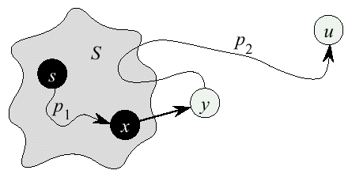
Dijkstra’s Correctness
We will prove that whenever u is added to S, u.d() = δ(s,u), i.e., that d is minimum, and that equality is maintained thereafter
Proof (by contradiction)
  Note that ∀v, v.d() ≥ δ(s,v)
  Let u be the first vertex picked such that there is a shorter path than u.d(), i.e., that ⇒ u.d() > δ(s,u)
  We will show that this assumption leads to a contradiction

Slide 15
Dijkstra Correctness (2)
Let y be the first vertex ∈V – S on the actual shortest path from s to u, then it must be that y.d() = δ(s,y) because
  x.d() is set correctly for y's predecessor x ∈S on the shortest path (by choice of u as the first vertex for which d is set incorrectly)
  when the algorithm inserted x into S, it relaxed the edge (x,y), setting y.d() to the correct value

Slide 16
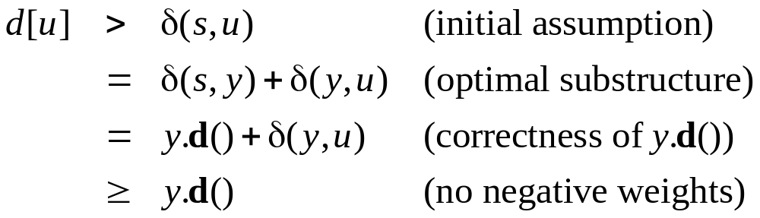
Dijkstra Correctness (3)
But u.d() > y.d() ⇒ algorithm would have chosen y (from the PQ) to process next, not u ⇒ contradiction
Thus, u.d() = δ(s,u) at time of insertion of u into S, and Dijkstra's algorithm is correct

Slide 17
Dijkstra’s Running Time
Extract-Min executed |V| time
Decrease-Key executed |E| time
Time = |V| T_{Extract-Min} + |E| T_{Decrease-Key}
T depends on different Q implementations
Q | T(Extract-Min) | T(Decrease-Key) | Total
array | Ο(V) | Ο(1) | Ο(V ²)
binary heap | Ο(lg V) | Ο(lg V) | Ο(E lg V)
Fibonacci heap | Ο(lg V) | Ο(1) (amort.) | Ο(V lgV + E)

Slide 18
Bellman-Ford Algorithm
Dijkstra’s doesn’t work when there are negative edges:
  Intuition – we can not be greedy any more on the assumption that the lengths of paths will only increase in the future
Bellman-Ford algorithm detects negative cycles (returns false) or returns the shortest path-tree

Slide 19
Bellman-Ford Algorithm
Bellman-Ford(G,s)
01 for each vertex u ∈ G.V()
02 u.setd(∞)
03 u.setparent(NIL)
04 s.setd(0)
05 for i ← 1 to |G.V()|-1 do
06 for each edge (u,v) ∈ G.E() do
07 Relax (u,v,G)
08 for each edge (u,v) ∈ G.E() do
09 if v.d() > u.d() + G.w(u,v) then
10 return false
11 return true

Slide 20
Bellman-Ford Example
t
5
x
t
5
x
∞
-2
∞
6
-2
∞
6
6
-3
-3
s
0
8
s
0
8
-4
7
-4
7
2
2
7
7
∞
∞
7
∞
9
9
y
z
y
z
t
5
x
t
5
x
6
-2
4
2
-2
4
6
6
-3
-3
s
0
8
s
0
8
-4
7
-4
7
2
2
7
7
7
2
7
2
9
9
y
z
y
z

Slide 21
Bellman-Ford Example
t
5
x
2
-2
4
6
-3
s
0
8
-4
7
2
7
7
−2
9
y
z
Bellman-Ford running time:
  (|V|-1)|E| + |E| = Θ(VE)

Slide 22
Correctness of Bellman-Ford
Let δ_{i}(s,u) denote the length of path from s to u, that is shortest among all paths, that contain at most i edges
Prove by induction that u.d() = δ_{i}(s,u) after the i-th iteration of Bellman-Ford
  Base case (i=0) trivial
  Inductive step (say u.d() = δ_{i-1}(s,u)):
    Either δ_{i}(s,u) = δ_{i-1}(s,u)
    Or δ_{i}(s,u) = δ_{i-1}(s,z) + w(z,u)
    In an iteration we try to relax each edge ((z,u) also), so we handle both cases, thus u.d() = δ_{i}(s,u)

Slide 23
Correctness of Bellman-Ford
After n-1 iterations, u.d() = δ_{n-1}(s,u), for each vertex u.
If there is still some edge to relax in the graph, then there is a vertex u, such that δ_{n}(s,u) < δ_{n-1}(s,u). But there are only n vertices in G – we have a cycle, and it is negative.
Otherwise, u.d()= δ_{n-1}(s,u) = δ(s,u), for all u, since any shortest path will have at most n-1 edges

Slide 24
Shortest-Path in DAG’s
Finding shortest paths in DAG’s is much easier, because it is easy to find an order in which to do relaxations – Topological sorting!
DAG-Shortest-Paths(G,w,s)
01 01 for each vertex u ∈ G.V()
02 u.setd(∞)
03 u.setparent(NIL)
04 s.setd(0)
05 topologically sort G
06 for each vertex u, taken in topolog. order do
07 for each v ∈ u.adjacent() do
08 Relax(u, v, G)

Slide 25
Shortest-Paths in DAG’s (2)
Running time:
  Θ(V+E) – only one relaxation for each edge, V times faster than Bellman-Ford

Slide 26
Next Lecture
Introduction to Complexity classes of algorithms
  NP-complete problems

